Slide 1


[Social Buzz Data Analysis Report]

Slide 2


Today's agenda
Project recap
Problem
The Analytics team
Process
Insights
Summary

Slide 3


- Social Buzz is a company that was created in 2010 by two engineers.
- Their main aim was to create a website who’s main mission was to make content the center stage.
- The three tasks are:
An audit of their best data practice.
Recommendations for a successful IPO.
An analysis of their content categories that highlights the top 5 categories with the largest aggregate popularity.
Project Recap

Slide 4


Problem
Creating an analysis of the content categories that highlight the top 5 categories with the largest aggregate popularity.

Slide 5




Yvonne Mwende Mbuvi (Data Analyst)
The Analytics team
Marcus Rompton (Senior Principal)
Andrew Fleming (Chief Technical Architect)

Slide 6

Process
1
Data Understanding
2
Cleaning of the data
3
Data Modelling
4
Data Analysis using Power BI
5
Uncover Insights

Slide 7


Insights

Slide 8
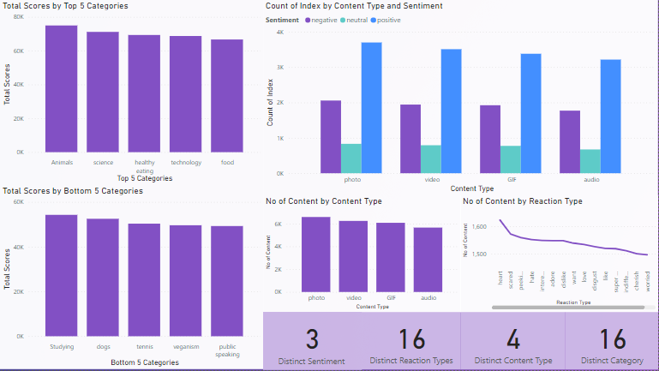

Slide 9
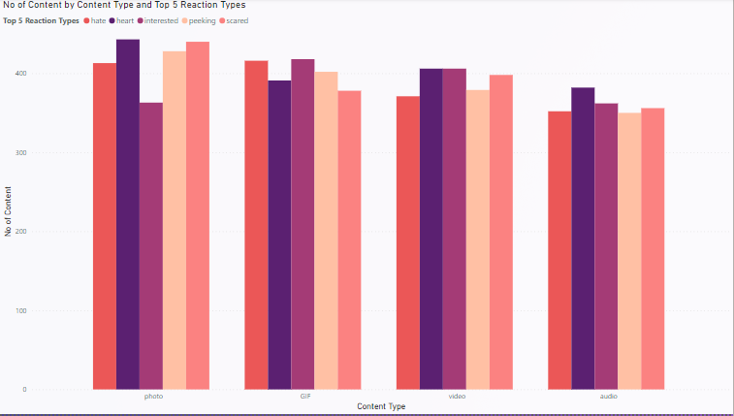

Slide 10


The top five categories are: Animals, Science, Healthy Eating, Technology, and Food.
The bottom five categories are: Studying, Dogs, Tennis, Veganism, and Public Speaking.
The content in these categories generally receives a positive sentiment, making it appealing to the target audience.
Among the various content types, photos generate the highest number of positive reactions. This could be attributed to the fact that they are the most frequently uploaded content type.
The most commonly used reaction type is the heart symbol.
However, the preferred reaction type varies across different content types. For GIFs, the "interested" reaction is the most popular, while videos tend to receive a mix of heart and interested reactions. In the case of audios, the heart reaction is predominantly used, and photos also receive a significant number of heart reactions.
To increase sales, the company should consider investing in creating more video and photo content.
Summary

Slide 11

Thank you!
ANY QUESTIONS?

